Slide 2
Chicken chat
#FeatheredFriday
What are the key words?

Slide 3
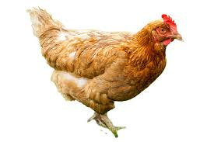
Chicken chat
#FeatheredFriday
hen

Slide 4
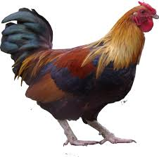
Chicken chat
#FeatheredFriday
cockerel

Slide 5
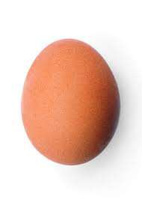
Chicken chat
#FeatheredFriday
egg

Slide 6
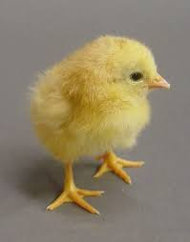
Chicken chat
#FeatheredFriday
chick

Slide 7
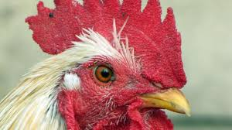
Chicken chat
#FeatheredFriday
comb
beak

Slide 8
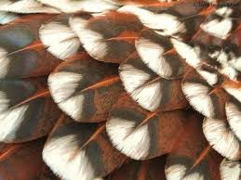
Chicken chat
#FeatheredFriday
feather

Slide 9
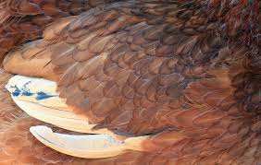
Chicken chat
#FeatheredFriday
wing

Slide 10
Chicken chat
#FeatheredFriday
Are you ready for the chicken challenge?

Slide 11
Chicken chat
#FeatheredFriday
Watch the #FeatheredFriday video

Slide 12
Chicken chat
#FeatheredFriday
There are more chickens in the world than humans? TRUE or FALSE

Slide 13
Chicken chat
#FeatheredFriday
There are more chickens in the world than humans? TRUE

Slide 14
Chicken chat
#FeatheredFriday
Chickens can run faster than people? TRUE or FALSE

Slide 15
Chicken chat
#FeatheredFriday
Chickens can run faster than people?
TRUE

Slide 16
Chicken chat
#FeatheredFriday
Chickens can fly.
TRUE or FALSE

Slide 17
Chicken chat
#FeatheredFriday
Chickens can fly?
TRUE

Slide 18
Chicken chat
#FeatheredFriday
There are 40 different breeds of chicken.
TRUE or FALSE

Slide 19
Chicken chat
#FeatheredFriday
There are 40 different breeds of chicken?
FALSE

Slide 20
Chicken chat
#FeatheredFriday
Hens begin to lay eggs when they are only 6 months old.
TRUE or FALSE

Slide 21
Chicken chat
#FeatheredFriday
Hens begin to lay eggs when they are only 6 months old.
TRUE

Slide 22
Chicken chat
#FeatheredFriday
Chickens usually live until they are 3 years old.
TRUE or FALSE

Slide 23
Chicken chat
#FeatheredFriday
Chickens usually live until they are 3 years old.
FALSE

Slide 24
Chicken chat
#FeatheredFriday
Chickens are related to the T-Rex.
TRUE or FALSE

Slide 25
Chicken chat
#FeatheredFriday
Chickens are related to the T-Rex.
TRUE

Slide 26
Chicken chat
#FeatheredFriday
Chickens lay eggs every day even when the eggs don’t contain a chick.
TRUE or FALSE

Slide 27
Chicken chat
#FeatheredFriday
Chickens lay eggs every day even when the eggs don’t contain a chick.
TRUE

Slide 28
LEAF Open Farm Sunday
LEAF Open Farm Sunday, managed by LEAF (Linking Environment And Farming), started in 2006. Since then over 1600 farmers across the UK have opened their gates and welcomed 2.2 million people onto their farm for one Sunday each year in June.
It is a fantastic opportunity for everyone, young and old, to discover at first hand what it means to be a farmer and the fabulous work they do producing our food, enhancing the countryside and all the goods and services farmers provide. Most events are free for you to visit too.
Each event is unique based around the farm’s individual story. Activities during the day may include a farm walk, nature trail, tractor and trailer rides, demonstrations, pond dipping, activities for children, a mini farmers market or farm shop.
Find this year’s date and search for your local farm here: https://farmsunday.org/visit-a-farm

